Slide 1

Computer Communications
& Networks
CSNC-2413
Week: 3
Computer Networking: A Top Down Approach
6th edition
Jim Kurose, Keith Ross
Addison-Wesley
March 2012
Access N/W, Core N/W
Circuit & Packet switching
Dr Nauman Mazhar
Faculty of Information Technology (FIT)
University of Central Punjab (UCP)

Slide 2
Chapter 1: roadmap
  1.1 what is the Internet?
  1.2 network edge
    end systems, access networks, links
  1.3 network core
    packet switching, circuit switching, network structure
  1.4 delay, loss, throughput in networks
  1.5 protocol layers, service models
  1.6 networks under attack: security
  1.7 history

Slide 3

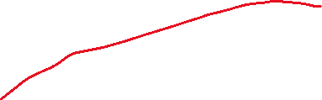
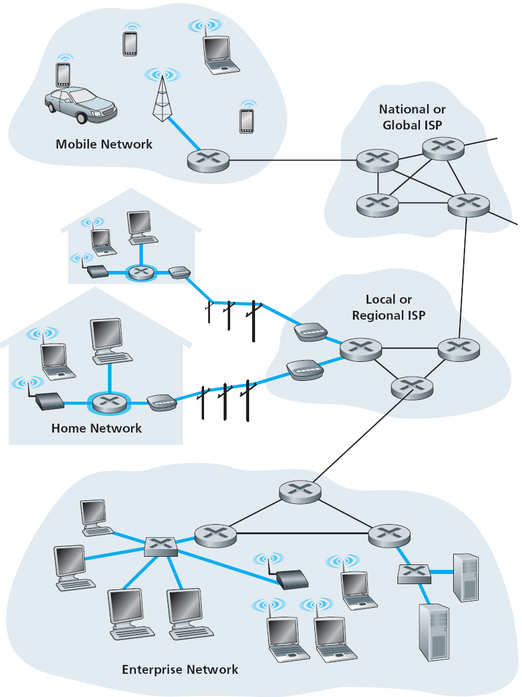



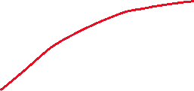



Network Structure
network edge:
  end systems
    hosts & apps
  access networks
    N/Ws to connect end
    systems to edge routers
    wired/wireless comm
    links
network core:
  interconnection of routers
  route pkts from src to dst
  circuit/packet switching

Slide 4
Access networks
“Networks to connect end systems to edge router”
Several types, in various settings…
  home access
  enterprise access
  wireless access
Vary based on…
type of media
data rate (bits per second)
range
access is shared/dedicated

Slide 5
1- Home Access
How homes connect to Internet
Digital Subscriber Line (DSL)
Cable Internet access
Fiber-to-the-Home (FTTH)
Dial up modem

Slide 6
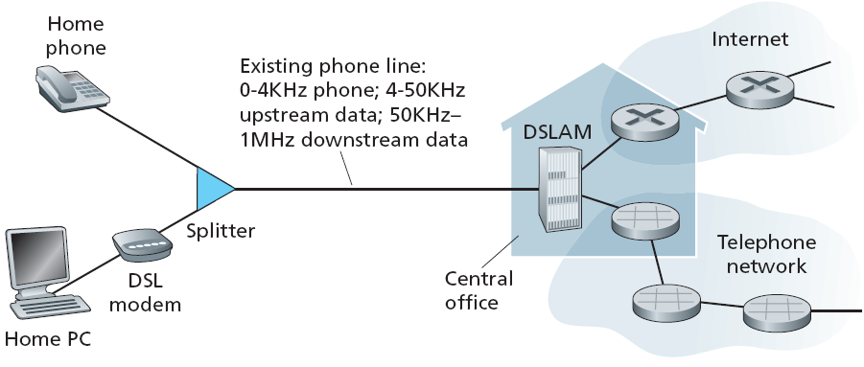
Access net: Digital subscriber line (DSL)
  Use existing telephone line to central office DSLAM for Internet access…
    telco is also the ISP
    dedicated line to ISP
    data & voice signals on same line – at different freq
    splitter & DSLAM separate data/voice signals
    DSL modem provides Ethernet connectivity

Slide 7
Access net: DSL
  DSL provides asymmetric access
  Typical transmission rates…
    upstream: 128 kbps to 1 Mbps downstream: 1 to 2 Mbps
  VDSL has higher transmission rates…
    upstream: 1.6 Mbps to 20 Mbps downstream: 12 to 55 Mbps
  Actual rate depends on link distance, wire gauge, elec interference

Slide 8
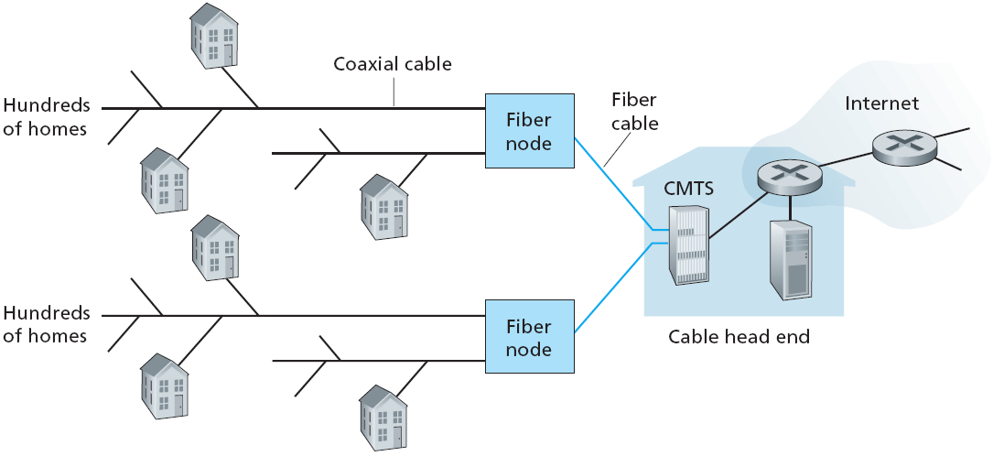
Access net: Cable network
Junction
Junction
  Use existing cable TV network for Internet access…
    cable TV provider is also the ISP
    data & video signals on same cable – at different freq
    fiber connects cable head end to neighborhood junctions
    coaxial cable then provides connections to homes
    cable modems at homes provides Ethernet connectivity

Slide 9
Access net: Cable network
HFC: hybrid fiber-coax
  Network of fiber/coax cable attaches homes to ISP router
homes share access network to ISP – shared medium
  bandwidth gets divided between users
  multiple access protocol needed to coordinate Tx
access is asymmetric
  upstream: 2 Mbps downstream: up to 30 Mbps

Slide 10
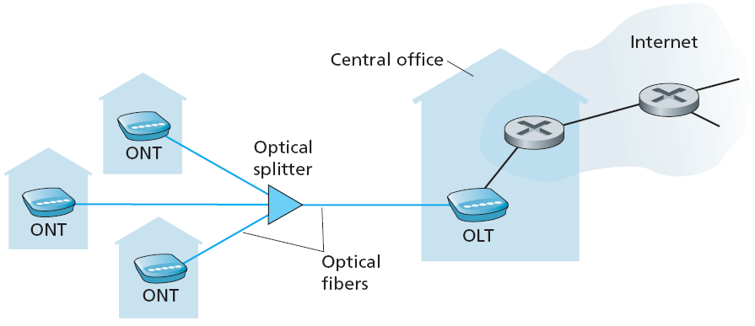
Access net: FTTH
  Optical fiber path from home to telco Central Office
    significantly higher Tx rates (1 Gbps)
    Internet, telephone & video services
  Technologies for optical distribution
    Direct Fiber : one fiber from CO to home
    Passive Optical Network (PON) : shared fiber

Slide 11
Access net: FTTH
  PON Architecture
  ONT (optical network terminator) connects home to neighborhood splitter
  Splitter combines signals on a shared fiber and connects to OLT
  (optical line terminator) at CO
  OLT provides electro/optical conversion, & connects to Internet via ISP router
  ONT provides Ethernet connectivity for home systems

Slide 12







Home access networks
wireless
devices
to headend or central office
often combined
in single box
Cable/ DSL modem, or ONT
wireless access point (54 Mbps)
router, DHCP, NAT, firewall
wired Ethernet (100 Mbps)

Slide 13
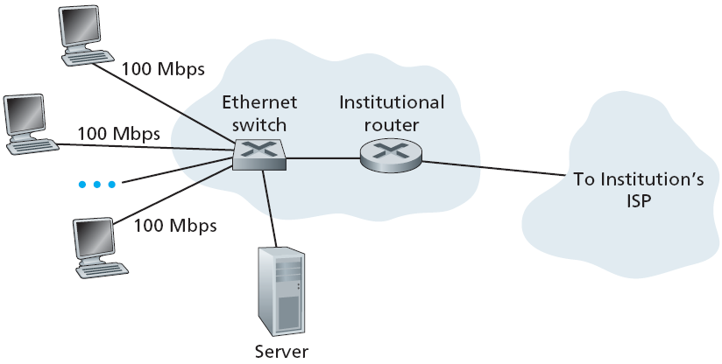
2 - Enterprise access N/W - Ethernet
Local Area Network (LAN) – connects end systems to edge router
Ethernet : most prevalent access N/W technology
  twisted pair copper wire & LAN switches
  dedicated link between host and switch
  typically: 100 Mbps to end systems 1 - 10 Gbps to servers

Slide 14









3 - Wireless access networks
Shared wireless access network connects end systems to edge router
  via “access point”or “base station”
Wide-area Wireless access:
  by cellular N/W operator
  range 10’s of kms
  data rate 1 – 100s of Mbps
  3G, 4G, LTE, WiMAX
Wireless LANs:
  within building – upto 100 m
  WiFi 802.11b/g/n
  11, 54, 600 Mbps data rate
to Internet
to Internet

Slide 15

Physical media
Physical medium: what lies between transmitter & receiver
carries bits – propagation of electrical signals, electromagnetic waves, or
optical pulses across physical medium
Guided media
  electrical signals propagate in solid media
  e.g, copper, fiber, coax
Unguided media
  electromagnetic waves propagate freely
  atmosphere, outer-space
Twisted pair (TP)
two insulated copper wires, in spiral pattern
  Category 5: 100Mbps, 1Gpbs Ethernet
  Category 6: 10Gbps

Slide 16


Physical media: Coax, fiber
Coaxial cable:
two concentric copper conductors, with shielding
bidirectional signal flow
shared medium
end systems connected directly
high bit rates – broadband
multiple channels on cable
Fiber optic cable:
glass fiber carrying light pulses,
each pulse a bit
carry tremendous bit rates
  (10 – 100 Gpbs)
long haul Tx media
  repeaters spaced far apart
low error rate
  immune to electromagnetic noise

Slide 17
Physical media: Radio
Radio Links
Carry signals in electro- magnetic spectrum
Charateristics…
  no physical “wire”
  penetrate walls
  support mobility
Propagation environment effects…
  reflection
  obstruction by objects
  interference
Types of radio links
Local Area
  wireless LAN (e.g, WiFi)
Wide Area (e.g, cellular)
  3G/4G; data rate in Mbps
Satellite
  link two ground stations
  geostationary vs low earth orb (LEO)
  speed upto 100s of Mbps
  end-end delay upto 280 msec

Slide 18
Chapter 1: roadmap
  1.1 what is the Internet?
  1.2 network edge
    end systems, access networks, links
  1.3 network core
    circuit switching, packet switching, network structure
  1.4 delay, loss, throughput in networks
  1.5 protocol layers, service models
  1.6 networks under attack: security
  1.7 history

Slide 19
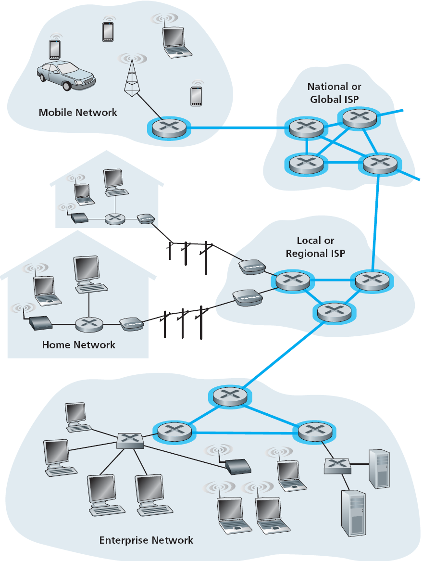
The network core
Mesh of interconnected routers
Fundamental question…
“how data is transferred thru N/W”
  Circuit switching
    resources along the path reserved for Tx duration
    e.g, telephone network
    guaranteed service
  Packet switching
    N/W resources used on demand
    e.g, Internet
    best effort service

Slide 20

Circuit switching
Network establishes an end-to-end circuit between hosts
Resources reserved for the “call” (B/W, buffer space)
Each link shown has four circuits
  call gets 2nd circuit in top link
  call gets 1st circuit in right link
dedicated resources, no sharing
  performance guaranteed
circuit segment idle, if not used by call (no sharing)

Slide 21
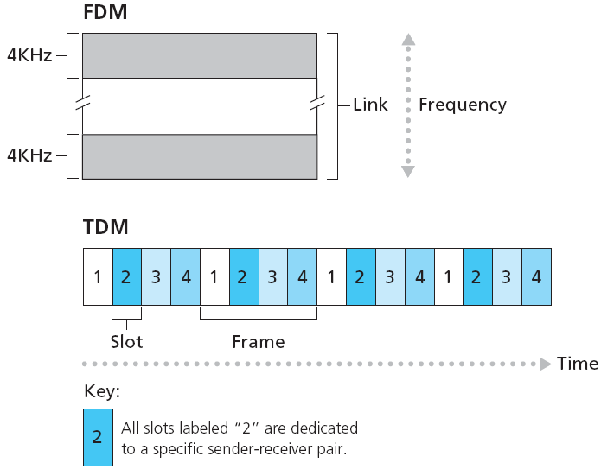
Multiplexing in Circuit switching
Circuits are implemented on a link using…
FDM (Freq Div Mux) or TDM (Time Div Mux)
FDM
freq spectrum divided into freq bands
each connection allocated a freq band
TDM
time divided into frames
frames have fixed slots
each connection allocated a time slot in every frame
Notes:
Two simple multiple access control techniques.
Each mobile’s share of the bandwidth is divided into portions for the uplink and the downlink. Also, possibly, out of band signaling.
As we will see, used in AMPS, GSM, IS-54/136

Slide 22
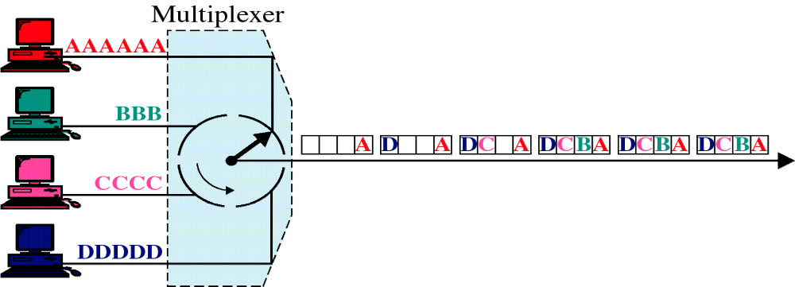
Time Division Mux (TDM)

Slide 23
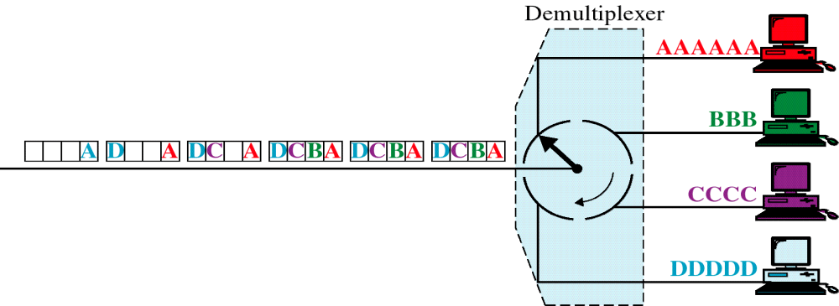
TDM : DeMux

Slide 24
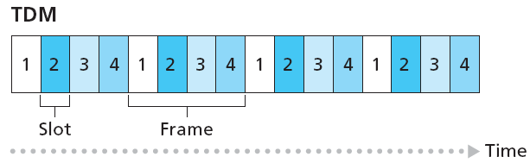
TDM circuit: data Tx rate
How to determine data Tx rates of TDM circuit/channel…
What is TDM circuit/channel…
Data Rate = Frame Rate x Slot Size
Given…
Frame rate = 8000 frames/sec
Slot size = 8 bits
Sol…
Data rate of one circuit = 8000 x 8 = 64 kbps
Data rate of TDM line = 8000 x (8 x 4) = 256 kbps
Notes:
Two simple multiple access control techniques.
Each mobile’s share of the bandwidth is divided into portions for the uplink and the downlink. Also, possibly, out of band signaling.
As we will see, used in AMPS, GSM, IS-54/136

Slide 25
TDM circuit: file Tx time
How much time it takes to send a 640 kbits file from Host A to Host B over a circuit switched network. All links in network use TDM with 24 slots and have a line rate of 1.536 Mbps. Also, it takes 500 ms to establish the circuit before transmission can take place.
Given…
TDM line rate = 1.536 Mbps Frame size = 24 slots
Circuit establishment delay = 500 ms File size = 640 kbits
Sol…
Data rate of one TDM circuit = 1.536 Mpbs / 24 = 64 kbps
Tx time of file = 640 kbits / 64 kbps = 10 sec
Total File sending time = 500 ms + 10 sec = 10.5 sec
(actual file sending time would also involve propagation delay…)
Notes:
Two simple multiple access control techniques.
Each mobile’s share of the bandwidth is divided into portions for the uplink and the downlink. Also, possibly, out of band signaling.
As we will see, used in AMPS, GSM, IS-54/136

Slide 26









Packet switching
Sources use network resources on demand
Hosts break application layer messages into smaller chunks – packets
Pkts forwarded from one router to next, across a set of links
  each pkt uses full data rate of link
Bandwidth division into “pieces”
Dedicated allocation
Resource reservation

Slide 27

Multiplexing in Packet switching: Statistical Mux
10 Mb/s
Ethernet
A
C
statistical multiplexing
1.5 Mb/s
B
queue of packets
waiting for output
link
D
E
Statistical Multiplexing:
  on-demand resource allocation, based on statistical pattern of pkt arrivals
  pkts of A & B do not have fixed time slots or sequence at output link
TDM had…
  pre-allocated time slots; each host gets same slot in all TDM frames

Slide 28
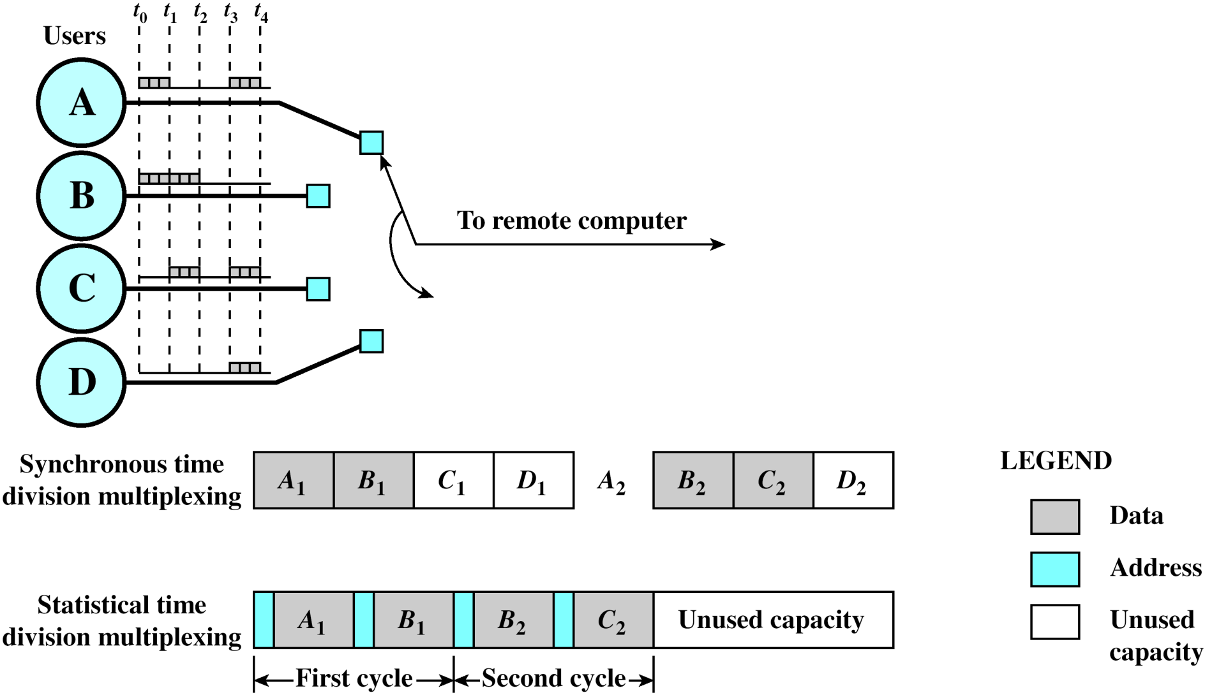
Statistical Mux vs TDM
Why do we need address here…??
Notes:
In a synchronous time division multiplexer, many of the time slots in a frame are often wasted. Statistical time division multiplexing provides a generally more efficient service than synchronous TDM for the support of terminals. With statistical TDM, time slots are not preassigned to particular data sources. Rather, user data are buffered and transmitted as rapidly as possible using available time slots. As with a synchronous TDM, the statistical multiplexer has a number of I/O lines on one side and a higher speed multiplexed line on the other. Each I/O line has a buffer associated with it. In the case of the statistical multiplexer, there are n I/O lines, but only k, where k < n, time slots available on the TDM frame. For input, the function of the multiplexer is to scan the input buffers, collecting data until a frame is filled, and then send the frame. On output, the multiplexer receives a frame and distributes the slots of data to the appropriate output buffers. Because statistical TDM takes advantage of the fact that the attached devices are not all transmitting all of the time, the data rate on the multiplexed line is less than the sum of the data rates of the attached devices. Thus, a statistical multiplexer can use a lower data rate to support as many devices as a synchronous multiplexer. However there is more overhead per slot for statistical TDM because each slot carries an address as well as data. The difficulty with this approach is that, while the average aggregate input may be less than the multiplexed line capacity, there may be peak periods when the input exceeds capacity. The solution to this problem is to include a buffer in the multiplexer to hold temporary excess input. There is a tradeoff between the size of the buffer used and the data rate of the line. We would like to use the smallest possible buffer and the smallest possible data rate, but a reduction in one requires an increase in the other.

Slide 29

Packet-switching Vs Circuit-switching
Packet switching may allow more users to use network…
10 users over 1 Mbps link
each Tx at 100 kbps when “active”;
but active 10% of time
Circuit-switching supports 10 users
Packet-switching allows more users because of Tx being intermittent
……...
N users
1 Mbps link
Packet switching may allow a user access to greater B/W…
In circuit-switching, user can only utilize his part of B/W
  1/10 of B/W for 10 users
In packet-switching, with less number of users active at any given time,
a user may avail more B/W

Slide 30
Packet-switching Vs Circuit-switching
Is packet switching a “ winner…?”
Great for bursty data
  resource sharing
  simpler, no call setup
Excessive congestion possible
  pkt delay & loss
  protocols needed for reliable data transfer, congestion control

Slide 31
Two key network-core functions
How do pkts make their way thru a pkt switched network…
Forwarding
move pkts from router’s input port
to appropriate output port
Routing
determine source-to-destination route taken by pkts
  routing algorithms
routing algorithm
local forwarding table
header value
output link
0100
0101
0111
1001
3
2
2
1
1
3
2
0111
dest address in arriving
packet’s header

Slide 32
Summary
  1.1 what is the Internet?
  1.2 network edge
    end systems, access networks, links
  1.3 network core
    packet switching, circuit switching, network structure
  1.4 delay, loss, throughput in networks
  1.5 protocol layers, service models
  1.6 networks under attack: security
  1.7 history

Slide 33
Circuit switching: Practice problems
One TDM channel supports data rate of 8 kbps. TDM line has a frame with 32 slots. What is the TDM line rate.
An FDM channel has data rate of 20 kbps. The line supports 12 parallel channels. What data rate will an application get if it is allocated 6 FDM channels for communication.
A network has TDM link with 32 slots. The aggregate line rate is 2.048 Mbps. If a file of size 1 MB is to be transferred across the link using one TDM channel, how much time will be taken. Consider that it takes 200 ms to first establish the TDM circuit before file can be sent.
Notes:
Two simple multiple access control techniques.
Each mobile’s share of the bandwidth is divided into portions for the uplink and the downlink. Also, possibly, out of band signaling.
As we will see, used in AMPS, GSM, IS-54/136

